Slide 1
Filter Design Introduction
2020-12-26

Slide 2
Outline
Butterworth Filter
Active filters
Low-pass filters
High-pass filters

Slide 3
Definitions – Low-pass Filter
§P.1 Butterworth Filter
Passband vs. Stopband (passband frequency is not -3dB frequency)
Passband ripple & Stopband attenuation
Not necessarily normalized to 0 dB

Slide 4
Definitions –High-pass Filter
§P.1 Butterworth Filter
Passband vs. Stopband (passband frequency is not -3dB frequency)
Passband ripple & Stopband attenuation

Slide 5
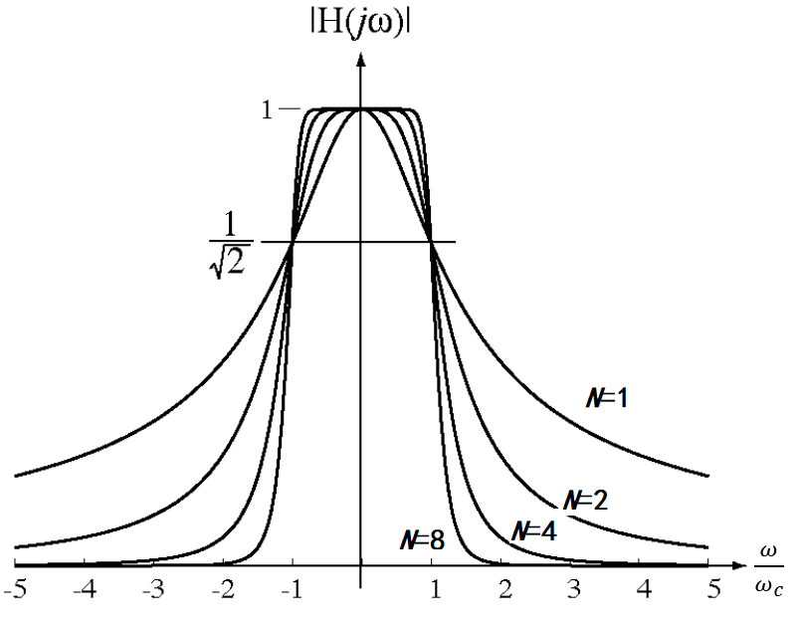
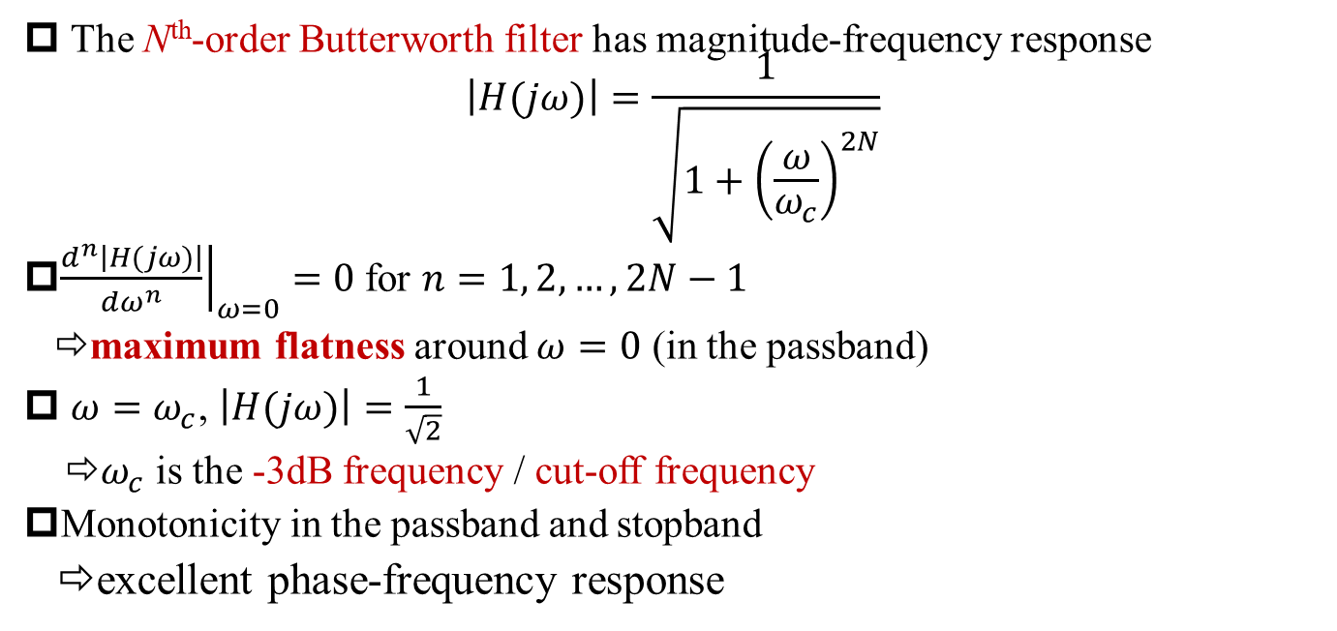
Butterworth Filter: Maximum Passband Flatness
§P.1 Butterworth Filter
The N^{th}-order Butterworth filter has magnitude-frequency response
$$\left|H(jω)\right|=\frac{1}{\sqrt{1+{\left(\frac{ω}{ω_{c}}\right)}^{2N}}}$$
${\left.\frac{d^{n}\left|H(jω)\right|}{dω^{n}}\right|}_{ω=0}=0$for $n=1, 2, …, 2N−1$
⇨maximum flatness around $ω=0$ (in the passband)
$ω=ω_{c}$, $\left|H(jω)\right|=\frac{1}{\sqrt{2}}$
⇨$ω_{c}$ is the -3dB frequency / cut-off frequency
Monotonicity in the passband and stopband
⇨excellent phase-frequency response

Slide 6
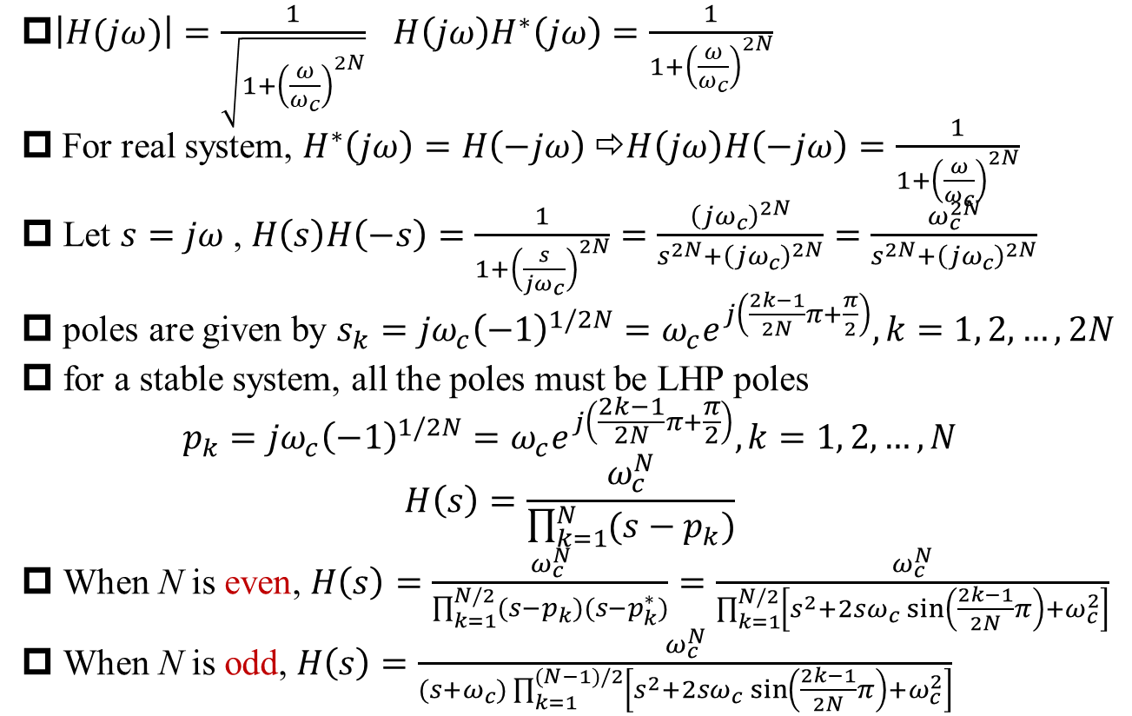
Poles and Transfer Function of Butterworth Low-Pass Filter
$\left|H(jω)\right|=\frac{1}{\sqrt{1+{\left(\frac{ω}{ω_{c}}\right)}^{2N}}}$ $H\left(jω\right)H^{∗}\left(jω\right)=\frac{1}{1+{\left(\frac{ω}{ω_{c}}\right)}^{2N}}$
For real system, $H^{∗}\left(jω\right)=H\left(−jω\right)$ ⇨$H\left(jω\right)H\left(−jω\right)=\frac{1}{1+{\left(\frac{ω}{ω_{c}}\right)}^{2N}}$
Let $s=jω$, $H\left(s\right)H\left(−s\right)=\frac{1}{1+{\left(\frac{s}{{jω}_{c}}\right)}^{2N}}=\frac{{\left({jω}_{c}\right)}^{2N}}{s^{2N}+{\left({jω}_{c}\right)}^{2N}}=\frac{ω_{c}^{2N}}{s^{2N}+{\left({jω}_{c}\right)}^{2N}}$
poles are given by ${s_{k}={jω}_{c}\left(−1\right)}^{1/2N}=ω_{c}e^{j\left(\frac{2k−1}{2N}π+\frac{π}{2}\right)}, k=1, 2, …, 2N$
for a stable system, all the poles must be LHP poles
$${p_{k}={jω}_{c}\left(−1\right)}^{1/2N}=ω_{c}e^{j\left(\frac{2k−1}{2N}π+\frac{π}{2}\right)}, k=1, 2, …, N$$
$$H\left(s\right)=\frac{ω_{c}^{N}}{\prod_{k=1}^{N}{(s−p_{k})}}$$
When N is even, $H\left(s\right)=\frac{ω_{c}^{N}}{\prod_{k=1}^{N/2}{(s−p_{k})(s−p_{k}^{∗})}}=\frac{ω_{c}^{N}}{\prod_{k=1}^{N/2}{\left[s^{2}+2sω_{c}\sin\left(\frac{2k−1}{2N}π\right)+ω_{c}^{2}\right]}}$
When N is odd, $H\left(s\right)=\frac{ω_{c}^{N}}{(s+ω_{c})\prod_{k=1}^{(N−1)/2}{\left[s^{2}+2sω_{c}\sin\left(\frac{2k−1}{2N}π\right)+ω_{c}^{2}\right]}}$
Q: Visualization of poles’ locations?

Slide 7
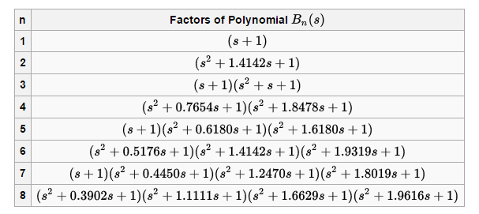
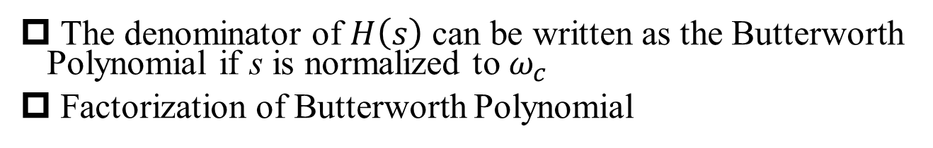
Butterworth Polynomial
§P.1 Butterworth Filter
The denominator of $H\left(s\right)$ can be written as the Butterworth Polynomial if s is normalized to $ω_{c}$
Factorization of Butterworth Polynomial

Slide 8
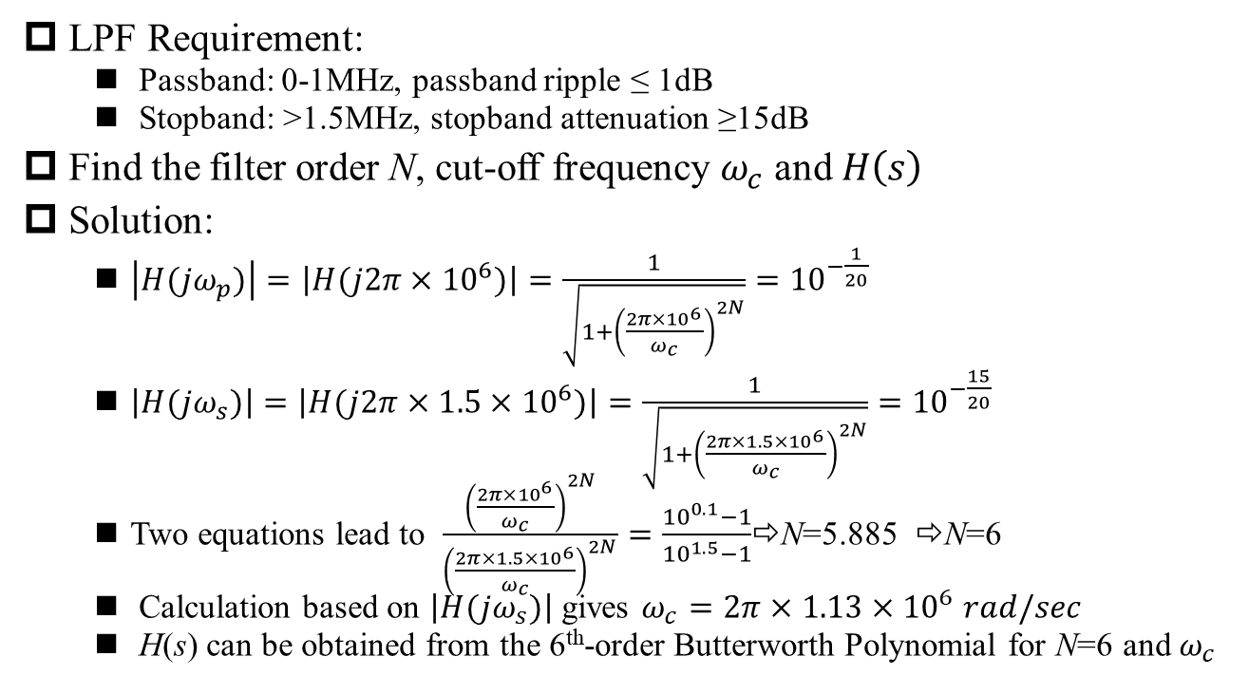
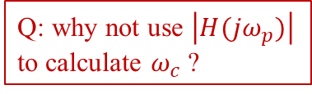
Design Example of Butterworth Low-Pass Filter
P.1 Butterworth Filter
LPF Requirement:
Passband: 0-1MHz, passband ripple ≤ 1dB
Stopband: >1.5MHz, stopband attenuation ≥15dB
Find the filter order N, cut-off frequency $ω_{c}$ and $H\left(s\right)$
Solution:
$\left|H(jω_{p})\right|=\left|H(j2π×{10}^{6})\right|=\frac{1}{\sqrt{1+{\left(\frac{2π×{10}^{6}}{ω_{c}}\right)}^{2N}}}={10}^{−\frac{1}{20}}$
$\left|H(jω_{s})\right|=\left|H(j2π×1.5×{10}^{6})\right|=\frac{1}{\sqrt{1+{\left(\frac{2π×1.5×{10}^{6}}{ω_{c}}\right)}^{2N}}}={10}^{−\frac{15}{20}}$
Two equations lead to $\frac{{\left(\frac{2π×{10}^{6}}{ω_{c}}\right)}^{2N}}{{\left(\frac{2π×1.5×{10}^{6}}{ω_{c}}\right)}^{2N}}=\frac{{10}^{0.1}−1}{{10}^{1.5}−1}$⇨N=5.885 ⇨N=6
Calculation based on $\left|H(jω_{s})\right|$ gives $ω_{c}=2π×1.13×{10}^{6} rad/sec$
H(s) can be obtained from the 6th-order Butterworth Polynomial for N=6 and $ω_{c}$
Q: why not use $\left|H(jω_{p})\right|$ to calculate $ω_{c}$ ?

Slide 9
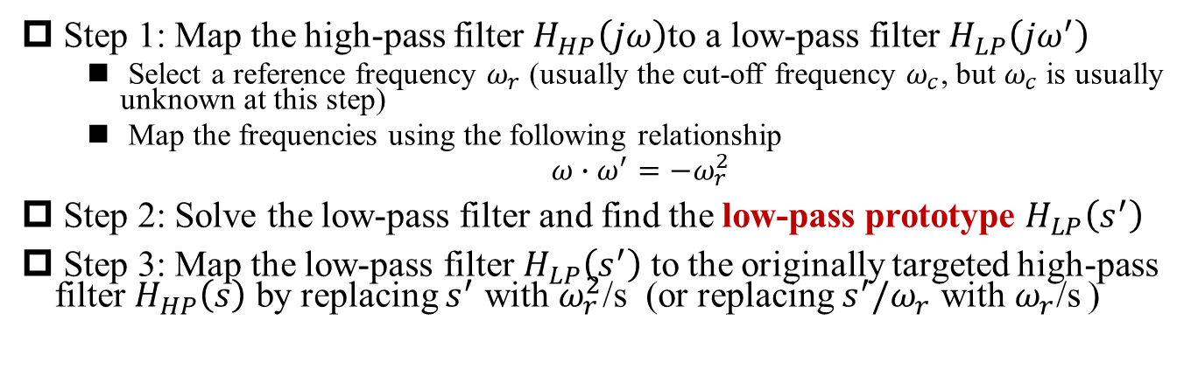
Design High-Pass Filter from Low-Pass Prototype Using Frequency Mapping
§P.1 Butterworth Filter
Step 1: Map the high-pass filter $H_{HP}\left(jω\right)$to a low-pass filter $H_{LP}\left(jω^{′}\right)$
Select a reference frequency $ω_{r}$ (usually the cut-off frequency $ω_{c}$, but $ω_{c}$ is usually unknown at this step)
Map the frequencies using the following relationship
$ω∙ω^{′}=−ω_{r}^{2}$
Step 2: Solve the low-pass filter and find the low-pass prototype $H_{LP}\left(s^{′}\right)$
Step 3: Map the low-pass filter $H_{LP}\left(s^{′}\right)$ to the originally targeted high-pass filter $H_{HP}\left(s\right)$ by replacing $s^{′}$ with $ω_{r}^{2}$/s (or replacing $s^{′}/ω_{r}$ with${ ω}_{r}$/s )

Slide 10
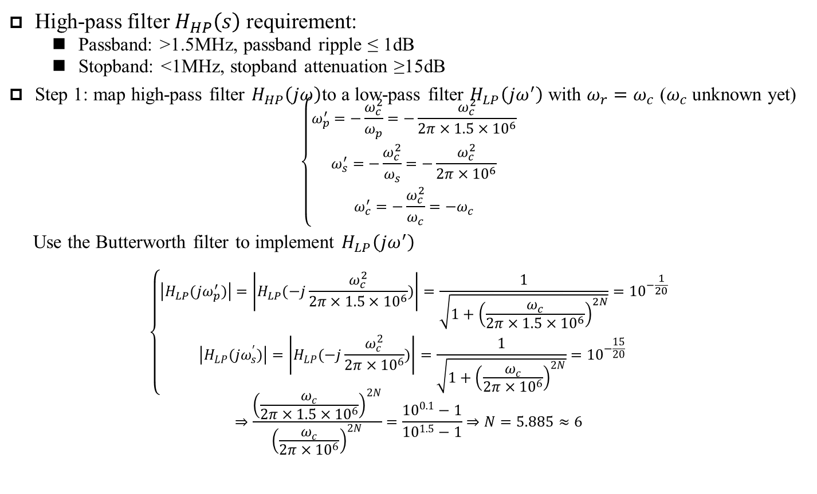
Design Example of Butterworth High-Pass Filter
§P.1 Butterworth Filter
High-pass filter $H_{HP}\left(s\right)$ requirement:
Passband: >1.5MHz, passband ripple ≤ 1dB
Stopband: <1MHz, stopband attenuation ≥15dB
Step 1: map high-pass filter $H_{HP}\left(jω\right)$to a low-pass filter $H_{LP}\left(jω^{′}\right)$ with $ω_{r}=ω_{c}$ ($ω_{c}$ unknown yet)
$$\left\{\begin{aligned}ω_{p}^{′}=−\frac{ω_{c}^{2}}{ω_{p}}=−\frac{ω_{c}^{2}}{2π×1.5×{10}^{6}} \\ ω_{s}^{′}=−\frac{ω_{c}^{2}}{ω_{s}}=−\frac{ω_{c}^{2}}{2π×{10}^{6}} \\ ω_{c}^{′}=−\frac{ω_{c}^{2}}{ω_{c}}=−ω_{c}\end{aligned}\right.$$
Use the Butterworth filter to implement $H_{LP}\left(jω^{′}\right)$
$$\left\{\begin{aligned}\left|H_{LP}(jω_{p}^{′})\right|=\left|H_{LP}(−j\frac{ω_{c}^{2}}{2π×1.5×{10}^{6}})\right|=\frac{1}{\sqrt{1+{\left(\frac{ω_{c}}{2π×1.5×{10}^{6}}\right)}^{2N}}}={10}^{−\frac{1}{20}} \\ \left|H_{LP}(jω_{s}^{′})\right|=\left|H_{LP}(−j\frac{ω_{c}^{2}}{2π×{10}^{6}})\right|=\frac{1}{\sqrt{1+{\left(\frac{ω_{c}}{2π×{10}^{6}}\right)}^{2N}}}={10}^{−\frac{15}{20}} \end{aligned}\right.$$
$$⇒\frac{{\left(\frac{ω_{c}}{2π×1.5×{10}^{6}}\right)}^{2N}}{{\left(\frac{ω_{c}}{2π×{10}^{6}}\right)}^{2N}}=\frac{{10}^{0.1}−1}{{10}^{1.5}−1}⇒N=5.885≈6$$

Slide 11
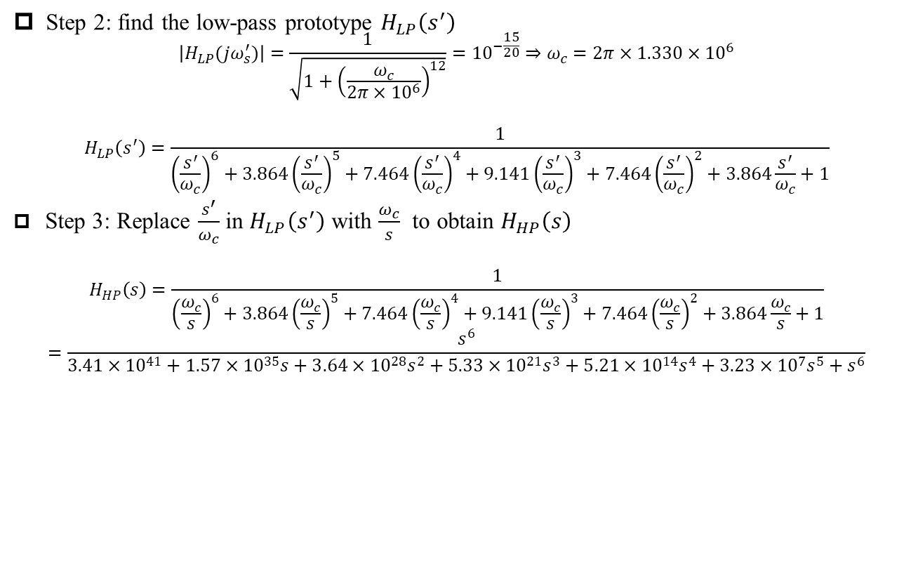
Design Example of Butterworth High-Pass Filter (cont’)
§P.1 Butterworth Filter
Step 2: find the low-pass prototype $H_{LP}\left(s^{′}\right)$
$$\left|H_{LP}(jω_{s}^{′})\right|=\frac{1}{\sqrt{1+{\left(\frac{ω_{c}}{2π×{10}^{6}}\right)}^{12}}}={10}^{−\frac{15}{20}}⇒ω_{c}=2π×1.330×{10}^{6}$$
$$H_{LP}\left(s^{′}\right)=\frac{1}{{\left(\frac{s^{′}}{ω_{c}}\right)}^{6}+3.864{\left(\frac{s^{′}}{ω_{c}}\right)}^{5}+7.464{\left(\frac{s^{′}}{ω_{c}}\right)}^{4}+9.141{\left(\frac{s^{′}}{ω_{c}}\right)}^{3}+7.464{\left(\frac{s^{′}}{ω_{c}}\right)}^{2}+3.864\frac{s^{′}}{ω_{c}}+1}$$
Step 3: Replace $\frac{s^{′}}{ω_{c}}$ in $H_{LP}\left(s^{′}\right)$ with $\frac{ω_{c}}{s}$ to obtain $H_{HP}\left(s\right)$
$$H_{HP}\left(s\right)=\frac{1}{{\left(\frac{ω_{c}}{s}\right)}^{6}+3.864{\left(\frac{ω_{c}}{s}\right)}^{5}+7.464{\left(\frac{ω_{c}}{s}\right)}^{4}+9.141{\left(\frac{ω_{c}}{s}\right)}^{3}+7.464{\left(\frac{ω_{c}}{s}\right)}^{2}+3.864\frac{ω_{c}}{s}+1}$$
$$=\frac{s^{6}}{3.41×{10}^{41}+1.57×{10}^{35}s+3.64×{10}^{28}s^{2}+5.33×{10}^{21}s^{3}+5.21×{10}^{14}s^{4}+3.23×{10}^{7}s^{5}+s^{6}}$$

Slide 12
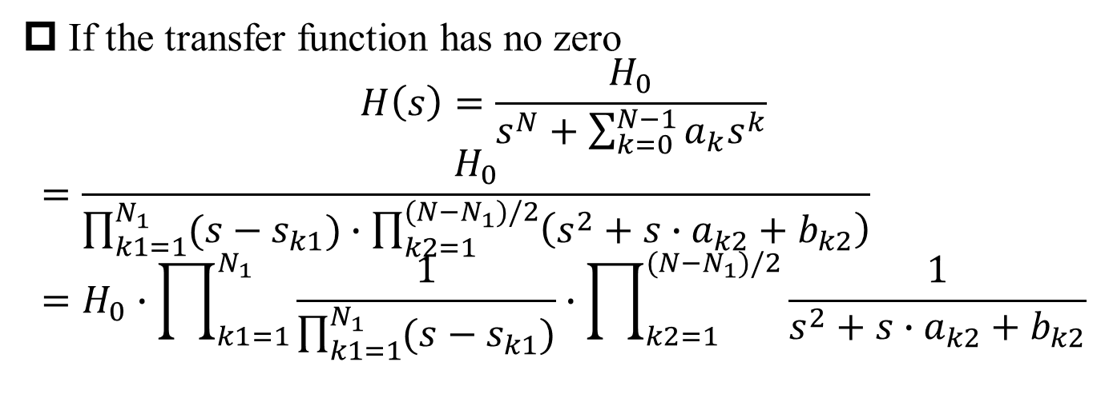
High-order Filter = Cascading of 1st-order filter(s) and 2nd-order filter(s)
§P.1 Butterworth Filter
If the transfer function has no zero
$$H\left(s\right)=\frac{H_{0}}{s^{N}+\sum_{k=0}^{N−1}{a_{k}s^{k}}}$$
$$=\frac{H_{0}}{\prod_{k1=1}^{N_{1}}{(s−s_{k1})}∙\prod_{k2=1}^{(N−N_{1})/2}{\left(s^{2}+{s∙a}_{k2}+b_{k2}\right)}}=H_{0}∙\prod_{k1=1}^{N_{1}}{\frac{1}{\prod_{k1=1}^{N_{1}}{(s−s_{k1})}}}∙\prod_{k2=1}^{(N−N_{1})/2}{\frac{1}{s^{2}+{s∙a}_{k2}+b_{k2}}}$$
Courtesy: https://www2.seas.gwu.edu/~ece121/Spring-11/filterdesign.pdf

Slide 13
First-Order Low-Pass Filter
§P.2 Active Filters
First-Order Noninverting Low-Pass Filter
First-Order Inverting Low-Pass Filter
Courtesy: https://www2.seas.gwu.edu/~ece121/Spring-11/filterdesign.pdf

Slide 14
Second-Order Sallen-Key Low-Pass Filter
§P.2 Active Filters
Courtesy: https://www2.seas.gwu.edu/~ece121/Spring-11/filterdesign.pdf
General Sallen-Key Low-Pass Filter
Unity-Gain Sallen-Key Low-Pass Filter

Slide 15
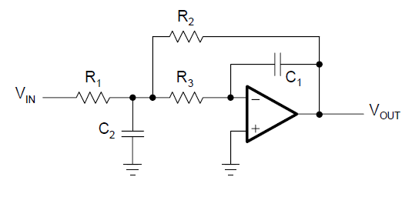
Second-Order Multiple Feedback (MFB) Low-Pass Filter
§P.2 Active Filters
Usually for high-Q filters
Courtesy: https://www2.seas.gwu.edu/~ece121/Spring-11/filterdesign.pdf

Slide 16
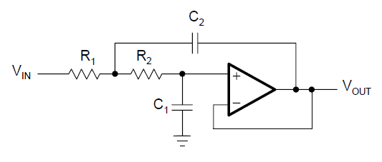
Conversion from Low-Pass Filter to High-Pass Filter
§P.2 Active Filters
Replace capacitors with resistors,
& replace resistors with capacitors
Courtesy: https://www2.seas.gwu.edu/~ece121/Spring-11/filterdesign.pdf

Slide 17
First-Order High-Pass Filter
§P.2 Active Filters
First-Order Noninverting High-Pass Filter
First-Order Inverting High-Pass Filter
Courtesy: https://www2.seas.gwu.edu/~ece121/Spring-11/filterdesign.pdf

Slide 18
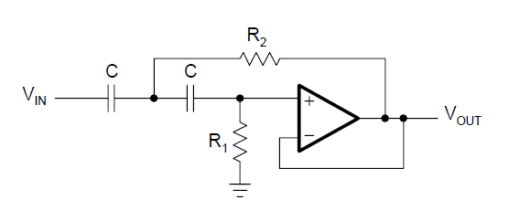
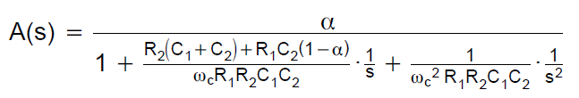
Second-Order Sallen-Key High-Pass Filter
§P.2 Active Filters
Courtesy: https://www2.seas.gwu.edu/~ece121/Spring-11/filterdesign.pdf

Slide 19
Second-Order Sallen-Key High-Pass Filter (Unity Gain)
§P.2 Active Filters
Courtesy: https://www2.seas.gwu.edu/~ece121/Spring-11/filterdesign.pdf

Slide 20
Second-Order Multiple Feedback (MFB) High-Pass Filter
§P.2 Active Filters
Courtesy: https://www2.seas.gwu.edu/~ece121/Spring-11/filterdesign.pdf

